Slide 1

http://nlc.nebraska.gov/grants/InnovationStudios

Slide 2
Library Innovation Studios: Transforming Rural Communities through Community Engagement
Presenters:
Add the Presenters Names & Contact Information Here

Slide 3
Today’s Agenda
“Library Innovation Studios” Project Overview
Statewide Partners & Funding Source
Local Community Action Team
Local Training Team
About the Equipment that makes Up the Studio
Questions & Answers

Slide 4
“Library Innovation Studios”
Project Overview
$530K Grant provided to Nebraska Library Commission by
Institute of Museum & Library Services (Federal Agency)
Uses (Makerspaces) hosted by public libraries to support:
  Community engagement
  Participatory learning experiences
  Access to technological and innovative learning tools not readily accessible locally
3-year Project (July, 2017 to July, 2020) allows for 30 public libraries to host Makerspace for 18 to 20 weeks
Allows communities to “try it before you buy it” and encourages local discussion around Makerspace benefits/how can our community support a makerspace?

Slide 5
Three Goals Guide the Library Innovation Studios (Makerspace) Project
Rural community residents will be empowered with the tools and guidance to explore, collaborate, create, learn, and invent;
Libraries (along with local partners) will transform their rural communities through participatory learning spaces, while establishing themselves as strong community catalysts for community change; and
Libraries and communities nationwide will have access to a replicable model.

Slide 6
How does the Projects Goals Overlap with our Community Goals?
…Empowered with the tools and guidance to explore, collaborate, create, learn, and invent;
  Entrepreneurship/Business Development
  Economic Development
  Lifelong Learning/Education
  STEAM – Science, Technology, Engineering, Art, Math
...Transform communities through participatory learning spaces…
  Sharing knowledge
  Learning from others
  Finding solutions together

Slide 7
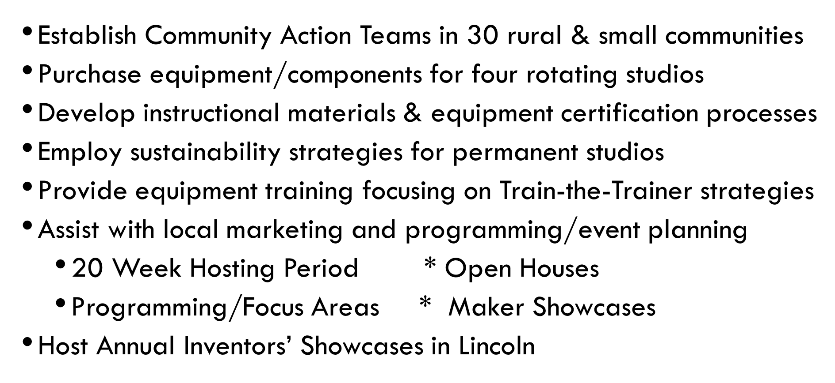
Multi-faceted project will…

Slide 8




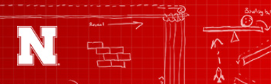

Statewide Partners:
Nebraska

Slide 9
Working Locally -- Community Engagement
Work as a Catalyst
  Getting people involved
  Getting people to work together
  Getting people to use their talents
Build a sense of community
  Meet people who are doing something different than you are
  Learn from each other
Understand the “benefits” and what a Makerspace means to the Community
Create a strong Community Action Team

Slide 10
Community Action Team
Identify 5 to 6 community leaders (or more)
  Representative of diverse aspects of community – Library, Chamber, Economic Development, Education, Extension, Business, Art Guild, Quilt Guild, Target Audiences, etc.
  Willing to make a commitment—spending time, energy, and talent to focus strategically and create a implementation plan
  Willing to engage and collaborate with community and key stakeholders
  Recruit others and their organizations to serve as trainers and/or participants
  Work with community to find resources (financial, human, ideas, etc.)

Slide 11
Community Action Team – ACTION STEPS
Volunteer Coordination
Getting People to the Conversations
Keeping People Engaged (Action Team Facilitation)
Playing a Role in Marketing
Maintaining the Momentum (taking steps for permanent studio)
  Scheduled regular time for briefings to discuss challenges/opportunities/ideas--communities with each other
Celebrating Success
  Local Maker Showcase
  Annual Inventors Fair at Nebraska Innovation Studio

Slide 12
FORMING TEAMS
Forming a Community Action Team
  Open House (dates, planning)
  Collect feedback
  Maker Showcase (dates, planning)
  Explore Options for Permanent Makerspace
Forming a Training Team
  Identify individuals with specific skills and interests and training/mentoring skills
  Collect feedback
  Provide training (individual & group)

Slide 13
Templates Available to you…
group)
Forming a Community Action Team
  Defines Role
  Suggests Ideas to Identify Stakeholders
  Covers Expectations (suggestions geared for success)
Forming a Training Team
  Defines Role
  Suggests Ideas to Identify Trainers & Mentors
  Covers Expectations (suggestions geared for success)
Event Planning Form

Slide 14
TRAINING TEAM – TRAIN THE TRAINER TRAININGS
group)
At Nebraska Innovation Studio, Lincoln – Add dates
Then again locally – Add dates
Then those trained become the Trainers
Learning Opportunities:
  Scheduled Trainings
  Certification Opportunities
  Forming Interest Groups (Formal and Informal)
  Focused & Free-form Local Group Learning Activities
  Mentor Monday (or something similar)

Slide 15
Library Innovation Studios
Host/Partner Libraries
1st Cycle: Plattsmouth, Ainsworth, Ashland,
Loup City & Crete
2nd Cycle: South Sioux, Neligh, Broken Bow, Bridgeport
3rd Cycle: Norfolk, No. Platte, Ravenna, Scottsbluff
Plus: Wayne Geneva, Central City, Nebraska City
Final Deadline for Public Libraries to apply to participate is May 18, 2018 – 13 libraries still to be selected.

Slide 16

Let’s Take A Look at the Stations & Kits Included with a Library Innovation Studio

Slide 17
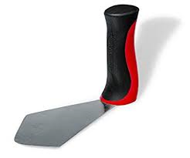
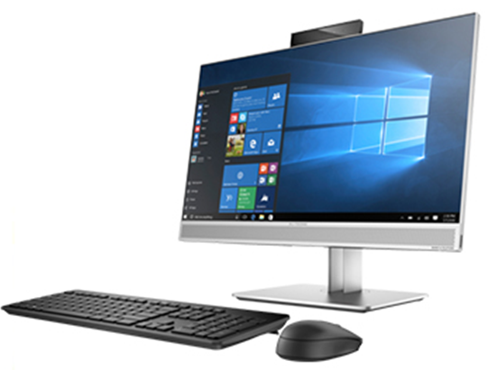
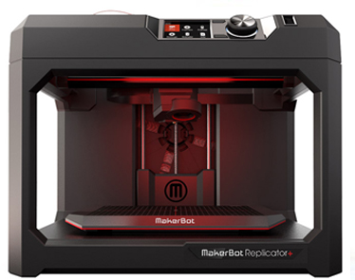
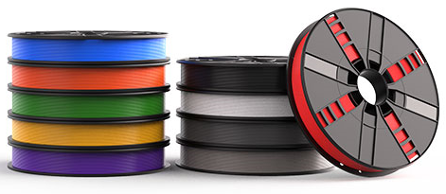
3D Printer Station
MakerBot Replicator+ 3D printer
HP EliteOne Desktop Computer
BuildTak Spatula
Consumables for sale: 10 colors of Filament (outside filament cannot be used)

Slide 18
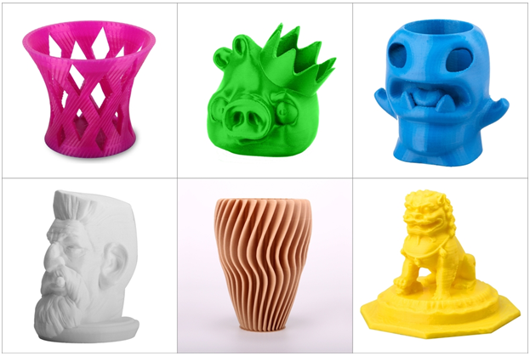
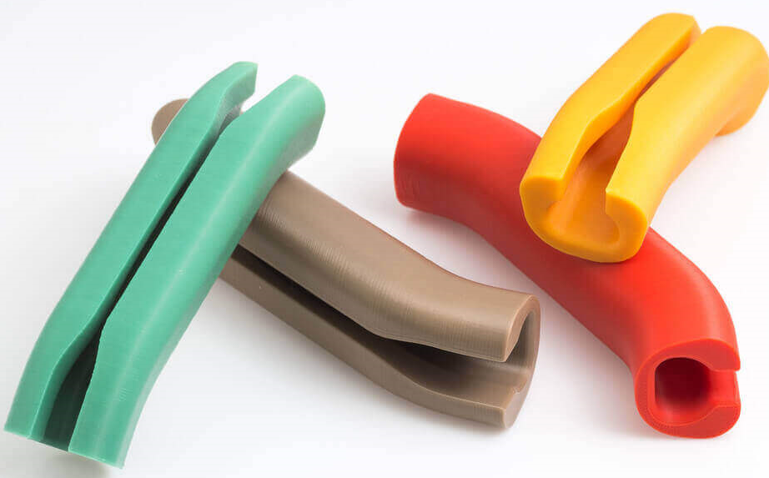
What Can you make with a 3D Printer?

Slide 19
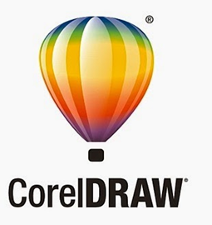
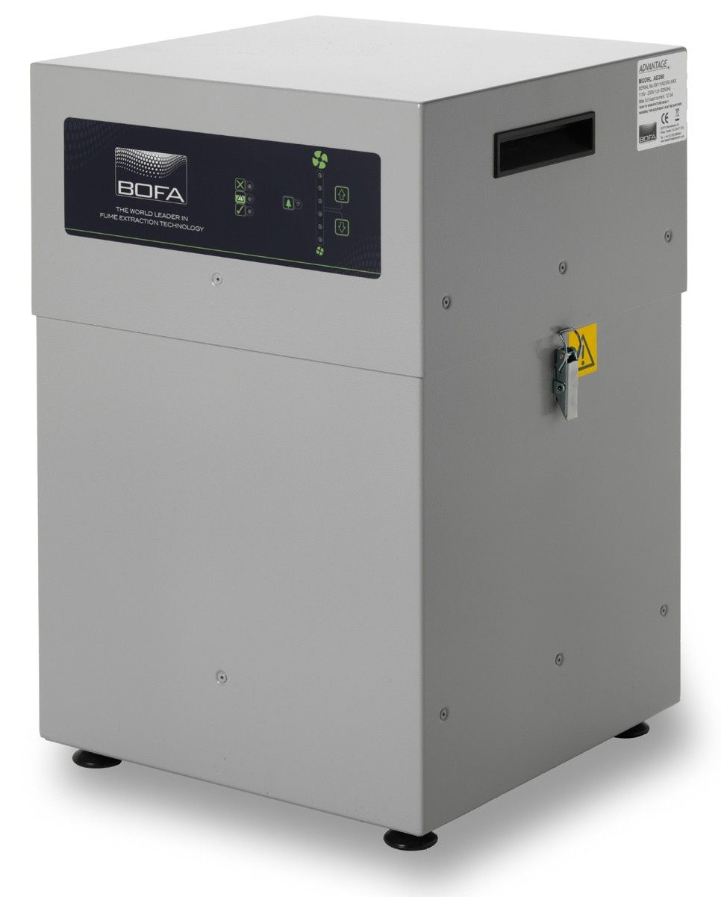
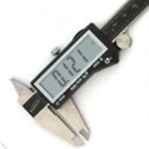
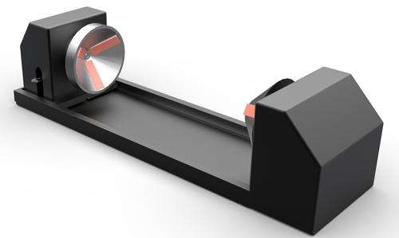
Laser Cutter Station
Universal Laser System VLS2.30 with 30W laser and Rotary Fixture
BOFA AD350 Laser Fume Extractor
HP EliteOne Desktop Computer with CorelDraw and One Touch Software
Caliper (measuring devise)
Consumables for sale: Birch Plywood, Cork coasters

Slide 20
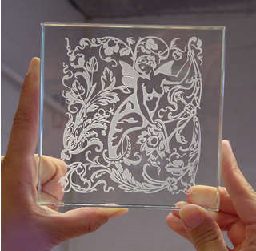
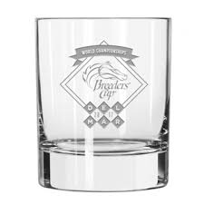

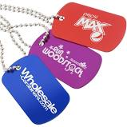
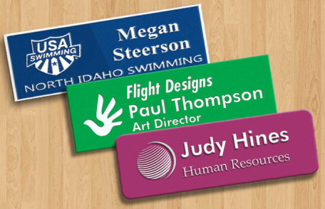
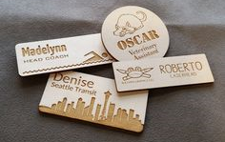
What Can you make with a Laser Cutter/Etcher?

Slide 21

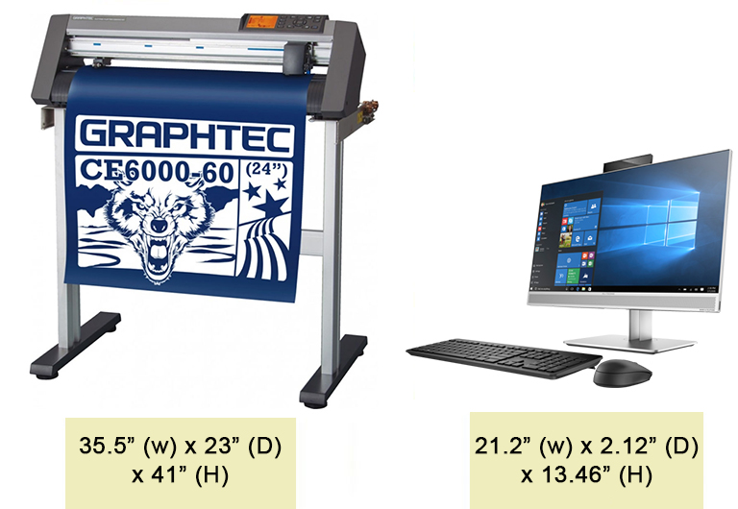
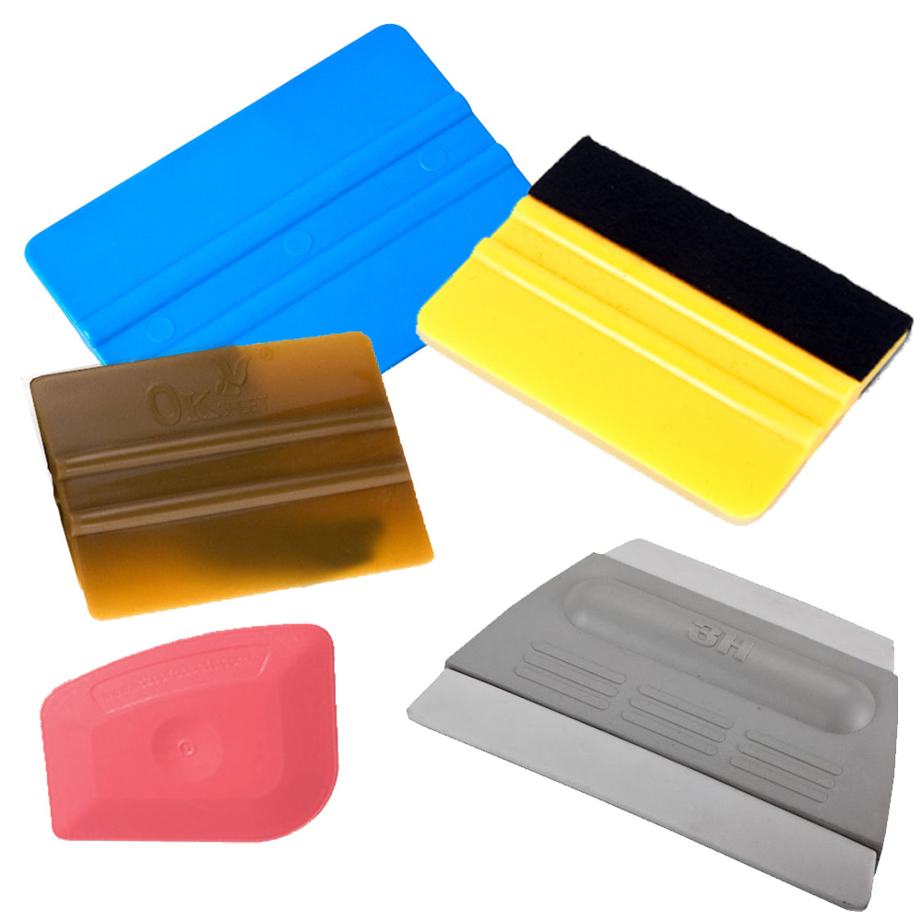
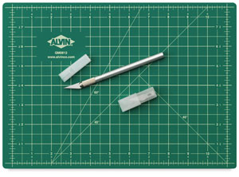
Vinyl Cutter Station
Graphtec CE6000-60 24” Wide E-Class Cutter & Stand
HP EliteOne Desktop Computer with CorelDraw
Alvin Pro Self Healing Cutting Mat
Exacto Knives, Squeegees/Burnishers
Consumables for sale: Removable Vinyl with Transfer Film

Slide 22
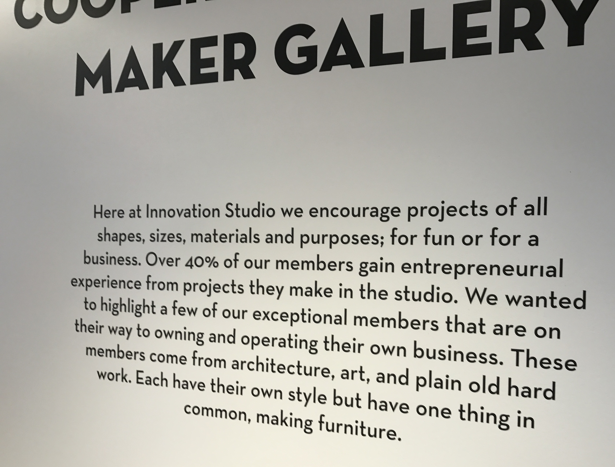
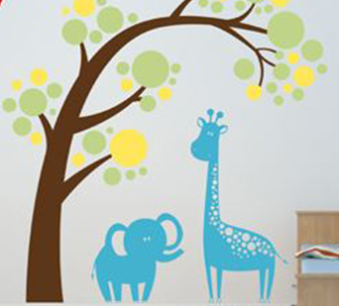

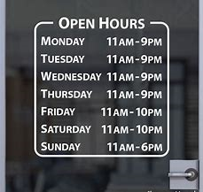

What Can you make with a Vinyl Cutter?

Slide 23
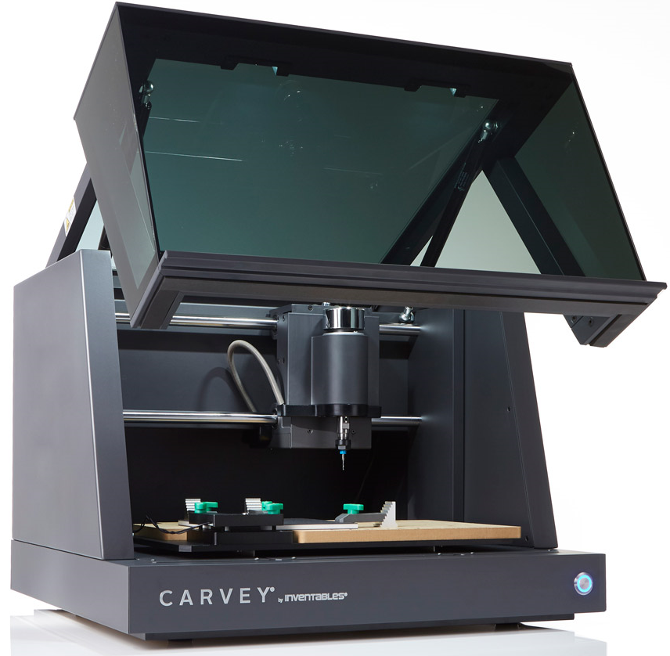
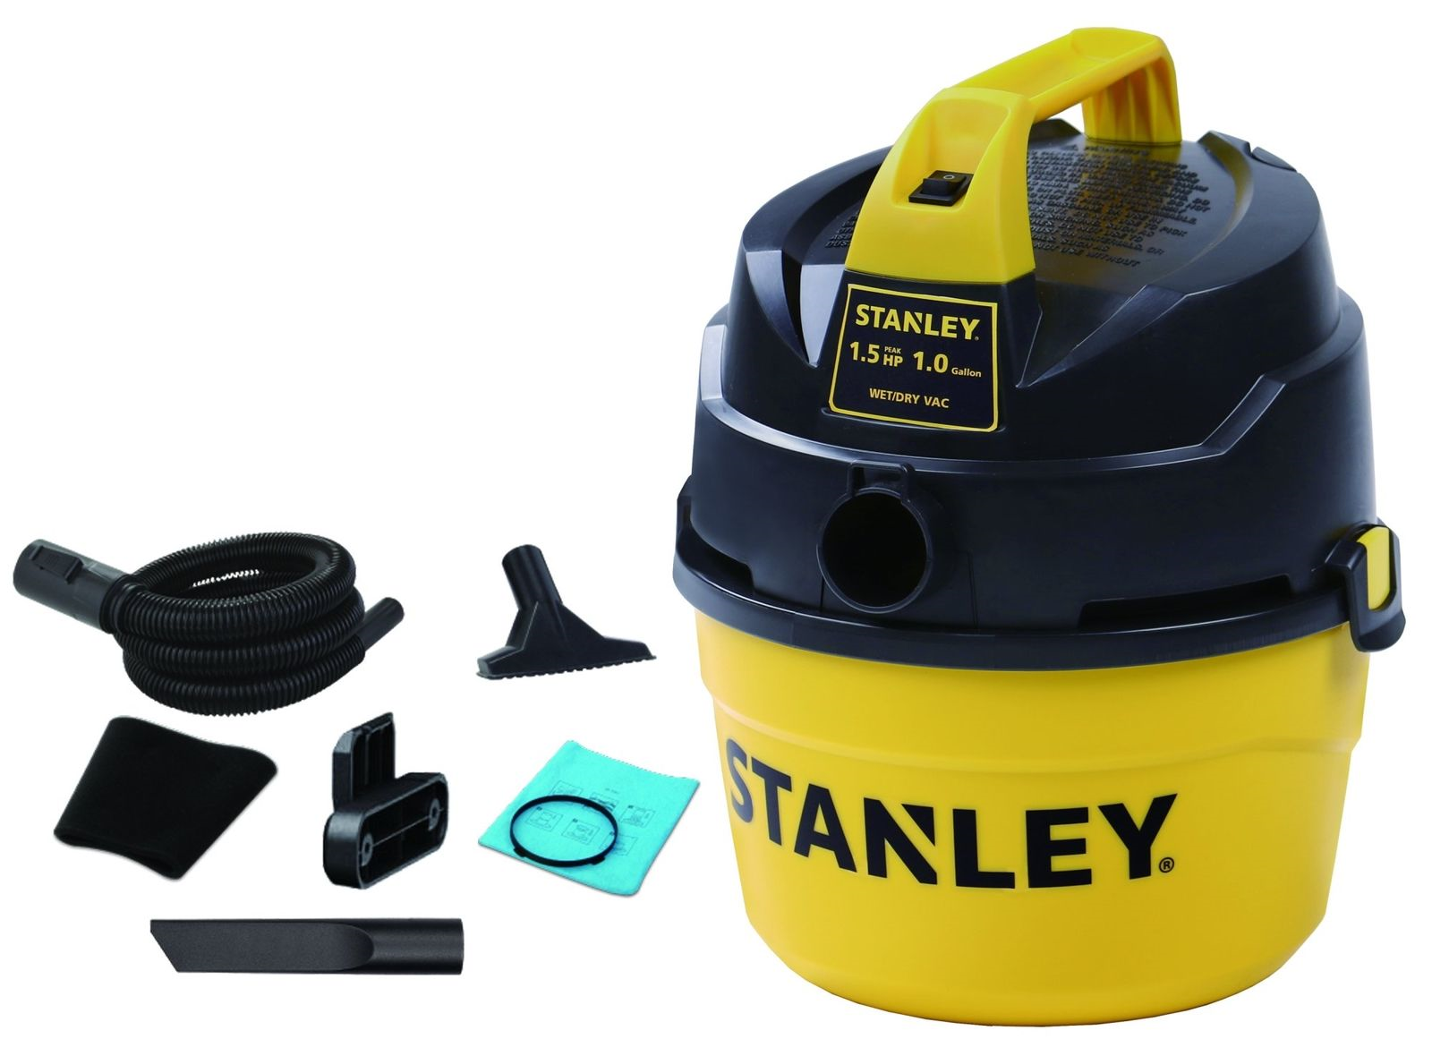
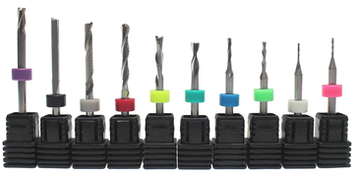
CNC Router/Inventables Carvey Plug & Play Station
Inventables Carvey Plug & Play CNC Router
Stanley 1-gallon shop vac
10 different carving and engraving bits
Consumables for sale: Birch plywood

Slide 24
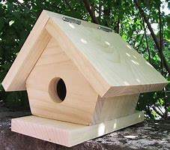
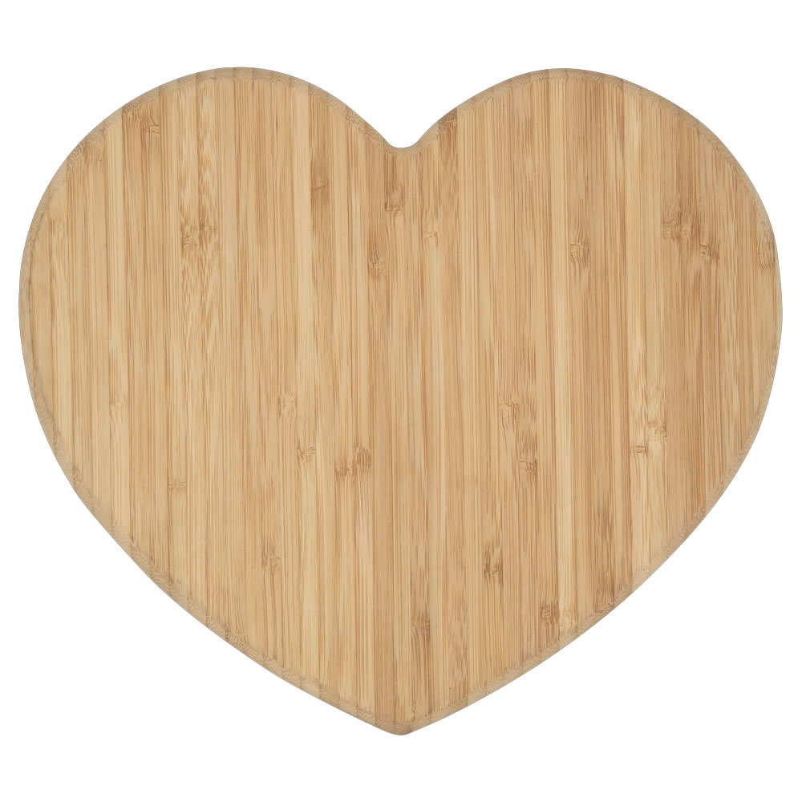

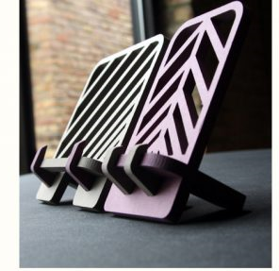
What Can you make with a CNC Router?

Slide 25

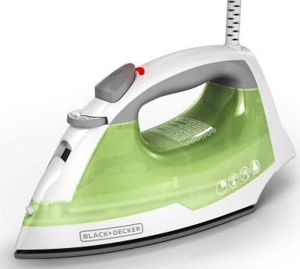
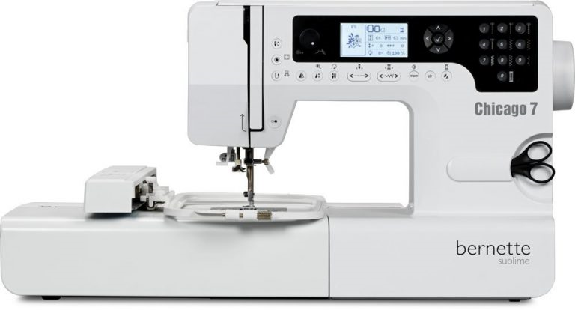
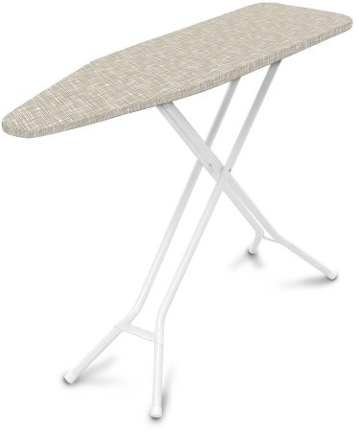
Bernette Chicago 7 Embroidery/Sewing Machine Station
Bernette Chicago 7 donated by Quality Sew & Vac, Grand Island, NE
Embroidery Patterns & Handy Roller Case
Black & Decker Steam Iron & Basic Ironing Board
Consumables for sale: Stabilizer (Thread provided at no cost; donations welcome)

Slide 26
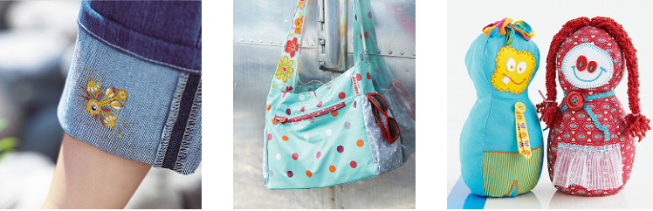
What Can you make with the bernette Chicago 7 Embroidery/Sewing Machine?

Slide 27
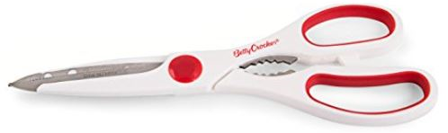
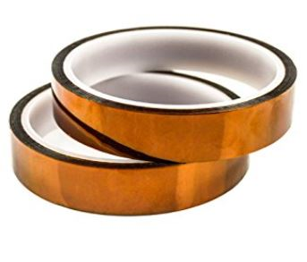
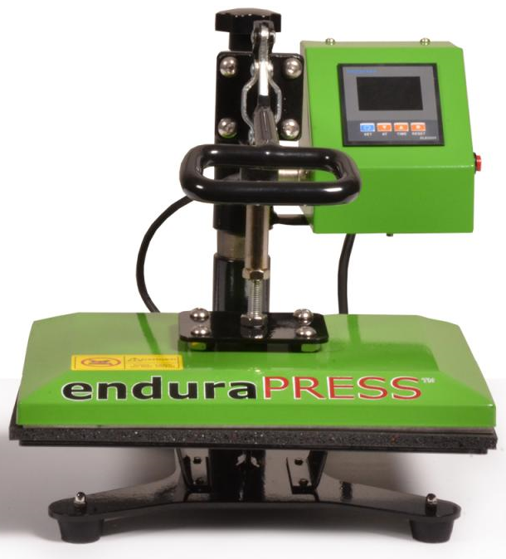
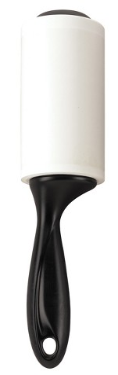
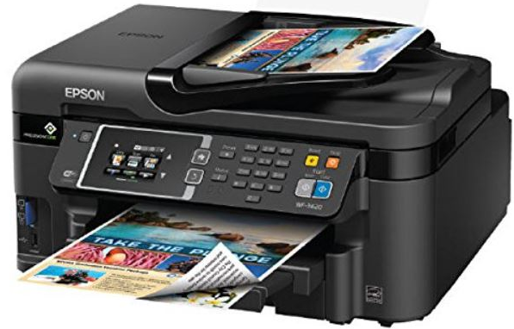
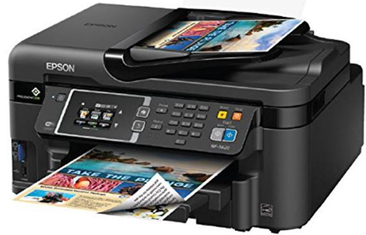
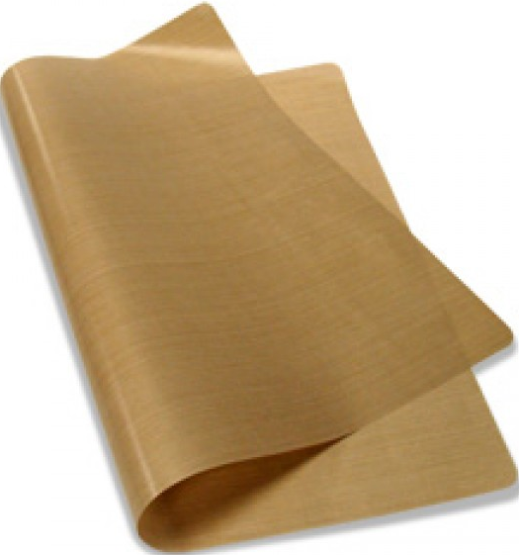
Heat Press + Sublimation & Pigment Printer Station
EnduraPress 9” x 12” Swing-Away Heat Press
HP EliteOne Desktop Computer with CorelDraw (same computer that runs Vinyl cutter)
Epson WF3620 Printer with Sublimation Ink
Epson WF3620 Printer with Pigment Ink
Supplies: Gloves, lint rollers, Teflon sheets, heat resistant tape, scissors
Consumables for sale: Heat transfer paper, T-Shirts

Slide 28
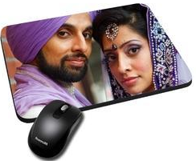
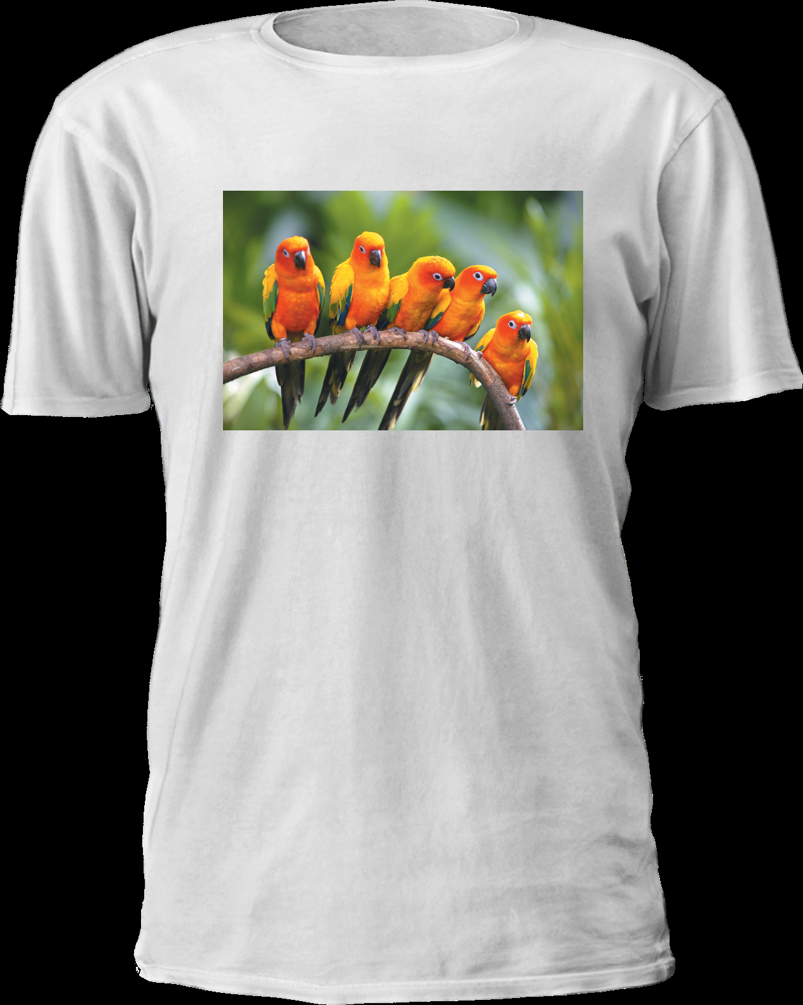

What Can you make with a Heat Press ?
You can use Sublimation or Pigment printed transfer paper with the heat press (available at your library). You can also heat press on ‘special’ vinyl (but not the vinyl that is available at the library. The vinyl available at the library is not “heat transfer” vinyl and cannot be used with the heat press.
The heat press will melt some types of fabrics and materials. Please read the SOP’s for more information.

Slide 29
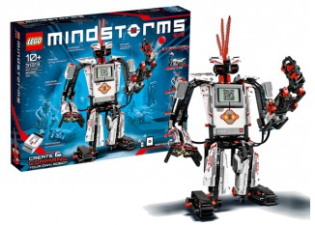
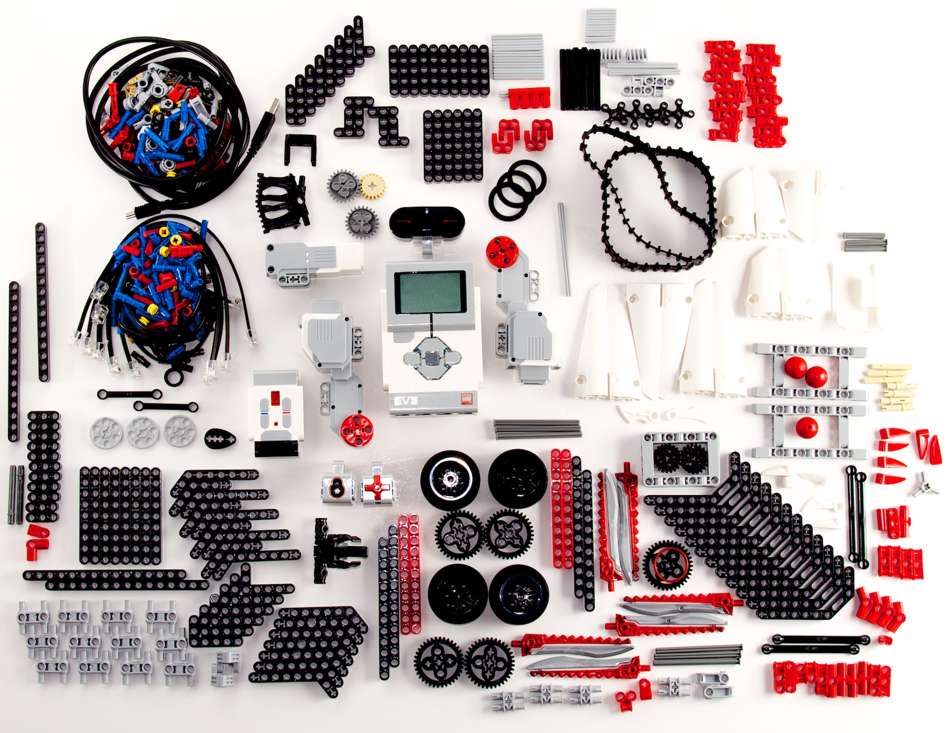
Lego Mindstorm EV3 Kit
https://www.lego.com/en-us/mindstorms/downloads/robot-commander-app
Build and program a personalized robot. Program your robot through an app (see web address above) on a mobile device or by using a personal or “Studio” laptop or others that may be available at the library.

Slide 30
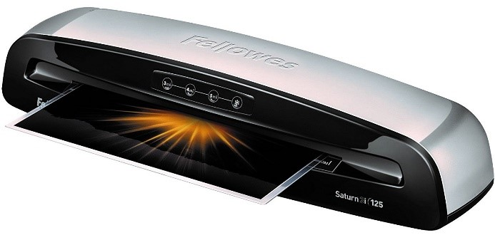
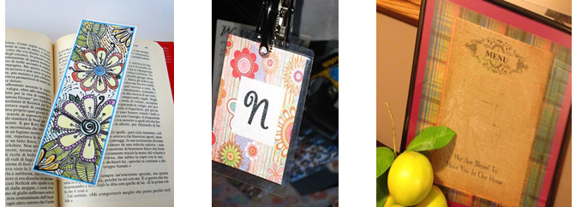
Laminator Kit & What you Can Make
Fellowes Laminator Saturen3i 125 HP EliteOne Desktop Computer with Consumables for sale: Laminator Sleeves in assorted sizes up to legal size to include luggage tag sleeves and loops

Slide 31
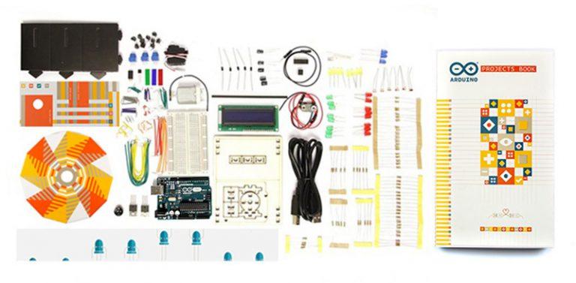
Arduino Starter Kit
The Arduino Starter Kit allows the user to become familiar with programming and includes 15 different projects. The kit may be powered through a connection with a laptop.

Slide 32
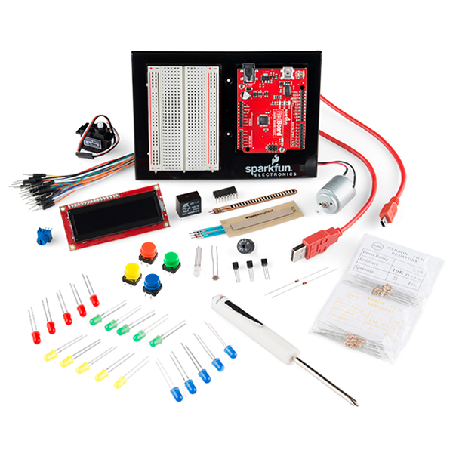
Sparkfun Inventor’s Kit
The SparkFun Inventor’s Kit allows users to construct a variety of circuits that use an Arduino Uno to read sensors, display information on an LCD, drive motors, and more. The kit will need to be connected to a laptop.
the SparkFun Inventor’s Kit. The kit allos users to construct a variety of circuits that use an Arduino Uno to read sensors, display information on an LCD, drive motors, and more. No previous programming or electronics experience is necessary. The kit will need to be connected to a laptop, which serves as both an interface and a power supply.

Slide 33
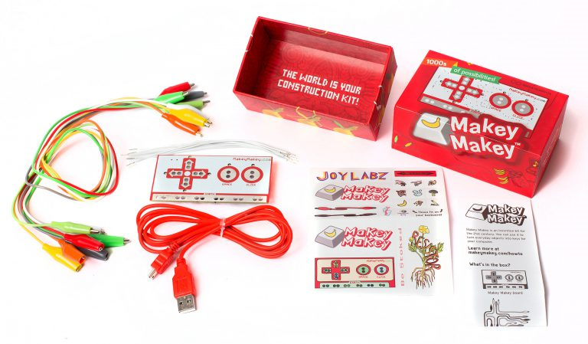
MakeyMakey Kit
The Makey Makey kit can turn everyday objects into touchpads and combine them with the internet. It’s a simple invention kit. Alligator clip two objects to the MakeyMakey board. Try turning banana’s into your keyboard!

Slide 34
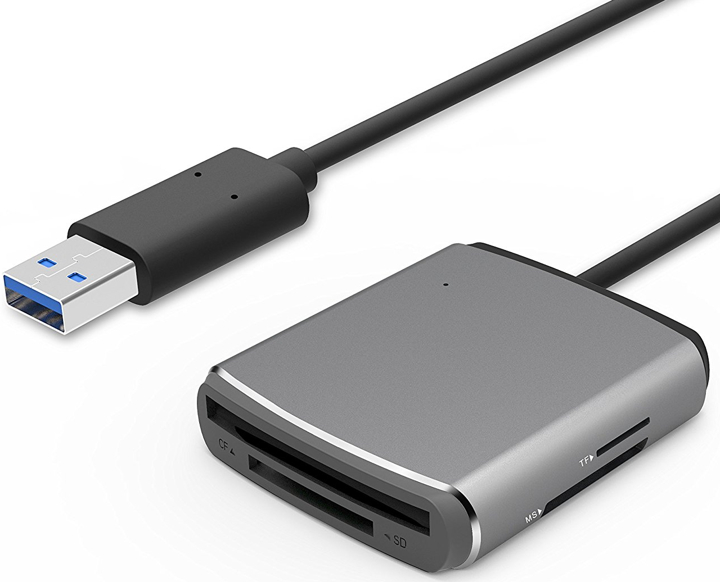



Camera/Video Kit
Cannon EOS Rebel T6 Digital SLR Camera w/18-55mm Lens + bundle w/Bag
Green Screen Fabric w/clamps, Frame and Carry Bag
Steamer (to help you get the wrinkles out of the green screen)
SD/TF/CF/MS USB 3.0 Card Reader

Slide 35






Music & Recording Kit
M-Audio Keystation 49 II, 49-Key USB MIDI Keyboard Controller
Yamaha HPH-50B Compact Closed-Back Headphones, 7.5, Black
Focusrite Scarlett Solo (2nd Gen) USB Audio Interface with Pro Tools
Shure SM58-LC Cardioid Dynamic Vocal Microphone & Sampson Boom Stand
Reaper Software on HP Probook Laptop
Assorted Speakers, Cables, Hubs, and Connectors.

Slide 36


2.25” Button Maker Kit
2.25” Button Maker
Graphic Punch for 2.25” Button Maker
Toolbox Filled with Supplies for Easy Making
Consumables for sale: Pin-Back, Mirror-Back, and Magnet-Back Buttons supplies

Slide 37






Other Supplies that come with your Library Innovation Studio
Two HP Probook Laptops along with the Four HP EliteOne Desktops to run all the devices (3 with CorelDraw)
Weller WLC100 40-Watt Soldering Station
5 lb Halotron Fire Extinquisher
Medique First Aid Kit
Glue Gun with Glue sticks

Slide 38
Questions/Answers/comments
The Library Innovation Studios: Transforming Rural Communities project is a partnership among the Nebraska Library Commission, University of Nebraska Lincoln (UNL), Nebraska Innovation Studio, Nebraska Extension, Regional Library Systems, and local public libraries—funded in part by the Institute of Museum and Library Services (Grant #LG-95-17-0046-17).

Slide 39
Statewide Contact Information
JoAnn McManus
Library Innovation Studios Project Manager
Nebraska Library Commission
402-471-4870
joann.mcmanus@nebraska.gov

