Slide 1

Nebraska
Library Innovation Studios
Policies
Presented by: Devra Dragos,
JoAnn McManus, & Max Wheeler
Train the

Slide 2




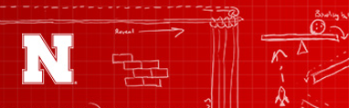

Nebraska
The Library Innovation Studios: Transforming Rural Communities project is a partnership among the Nebraska Library Commission, University of Nebraska Lincoln (UNL), Nebraska Innovation Studio, Nebraska Extension, Regional Library Systems, and local public libraries—funded in part by the Institute of Museum and Library Services (Grant #LG-95-17-0046-17).

Slide 3
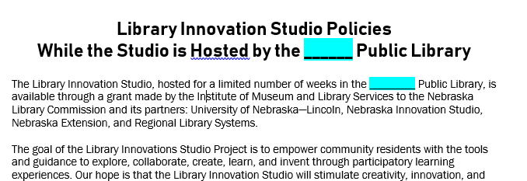
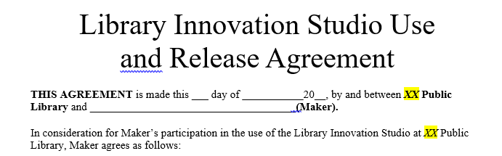
Resources Available to Host Libraries (ask for these if you can’t find them):
Library Innovation Studio Policies (Revised 4/25)
Library Innovation Studio Use
and Release Agreement
Nebraska

Slide 4
  Today’s Agenda
  Summary of the draft Library Innovation Studio Policy
  Host Libraries are to:
  Finalize the policy
  Have the Library board approve the Policy before the Library Innovation Studio is open to the public.
  Submit the approved Policy to JoAnn McManus for NLC’s records.
Nebraska

Slide 5
General Rules/Policies
  Post the hours the Studio/equipment is available to certified makers.
  The library WILL NOT charge for the use of any equipment.
  The library will charge for the Commission’s consumables used in the making process as noted on the price listing (prices include tax).
Nebraska

Slide 6
  Equipment may be used by any visitor who meets the training and minimum age requirements as posted.
  Makers may make items for both personal and commercial use. Entrepreneurship is encouraged.
  Makers will not access consumables for sale without assistance of Library staff or Trainers.
  The Library will not offer refunds for consumables purchased and used.
Nebraska

Slide 7
  Users may bring in their own consumables to use (other than the 3D filament which must be purchased from NLC stock for the safety of the machine.)
  Library staff must approve all user-supplied materials before they are used for safety issues (noxious fumes, items that will damage the machine).
  The maker agrees Library is not responsible for failed projects for any reason.
Nebraska

Slide 8
  A Library Innovation Studio Use and Release Agreement must be signed by all makers (or the parent/legal guardian for makers under age 19) prior to using Studio equipment
  All of the Library’s policies (behavior, etc.) also applies to the Studio.
  The Library may suspend or deny access to the Studio for persons who fail to follow Studio Policies.
Nebraska

Slide 9
  All makers must participate in training to receive certification before using Studio equipment as specified on the “use and training chart.”
  Contact information with email addresses of makers will be entered into the certification database.
  Library staff will ensure makers are certified before using equipment.
  Equipment not requiring training should be used in a safe and proper manner.
Nebraska

Slide 10
  All makers must sign-in at the front desk before using Studio equipment. (Optional)
  The Library may establish a Studio equipment reservation system.
  The Library may restrict the amount of time that makers are permitted (per day and/or per week) on any piece of equipment.
  If no reservation system is used, equipment will be available on first come, first served basis. However, time limits may be imposed.
Nebraska

Slide 11
  Some Studio Equipment must never leave the library during the hosting period.
  Other equipment may be removed for programming or promotion by local project partners.
  A select few items could be checked out by patrons if the library wishes to do that. (see chart in policies document available to host libraries)
Nebraska

Slide 12
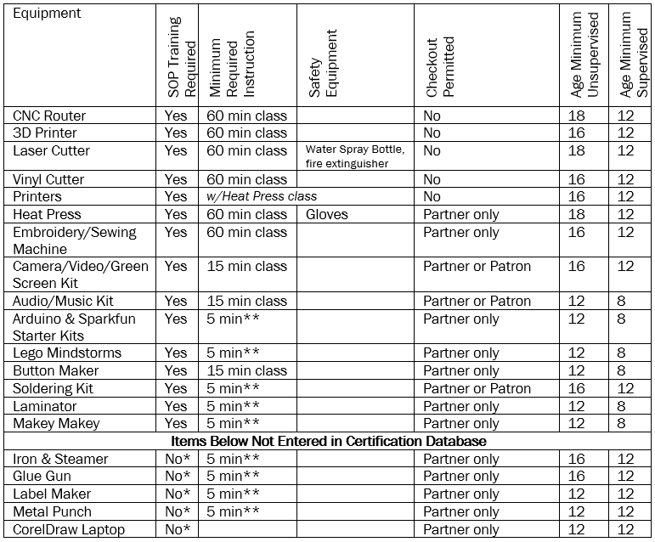
Nebraska

Slide 13
  The maker should not use Studio equipment to create or modify objects that are:
  * Prohibited by local, state, or federal law,
  * Unsafe, harmful, dangerous, or pose a perceived or immediate threat to the well-being of others (this means perceived or real weapons of any kind,
  including toy weapons).
  *Obscene or otherwise inappropriate for the Studio and library environment.
Nebraska

Slide 14
  Makers will follow all applicable intellectual property laws, including all copyright laws.
  Users must leave equipment in the same or better condition when done (exception: A Lego Mindstorms robot created does not need to be taken apart if it fits within the gray tote.
  Makers agree to take precautions to avoid causing unnecessary mess or damage.
  No food, gum, or drinks allowed near equipment.
Nebraska

Slide 15
  Library is not responsible for projects or materials left behind
  Library is not responsible for digital files left on computers.
  Makers agree to avoid wasting consumable supplies and materials. (Optional) (This would apply to consumables not purchased by the maker such as supplies that might have been donated or provided by the library)
Nebraska

Slide 16
Safety Guidelines (included in policies)
  Makers will follow all equipment safety procedures.
  Makers should use proper safety attire as outlined in the SOPs (gloves for heat press).
  Closed-toed shoes are highly recommended.
  Makers should secure long hair, lanyards, etc, that could catch in the equipment.
  Makers should not use headphones (except for music kit or video kit), ear buds, or cell phones while operating machinery.
Nebraska

Slide 17
  Makers and supervising adults are to be present while the equipment is running (other than long 3D print jobs.
  If any equipment becomes unsafe or in disrepair, immediately discontinue use and notify Library staff (Library staff then contacts Project team). Provide any loose or broken parts to Staff (Keep for project team).
  Makers must report to staff any accident or injury that occurs.
Nebraska

Slide 18
  Makers will turn off and unplug the Steamer, Iron, Heat Press, Laminator, and Soldering Iron after use to prevent burns and fire.
  Unsafe behavior is not permitted and should be reported to staff.
  Library may limit the number of spectators to prevent distractions during equipment operation.
  The Library may deny access to Studio equipment for persons who fail to follow general safety precautions or who put themselves or others at risk.
Nebraska

Slide 19
Nebraska
Train the
Questions?

Slide 20
Nebraska
  http://nlc.nebraska.gov/grants/innovationstudios/
http://nlc.nebraska.gov/grants/innovationstudios

Slide 21
Contact Information
JoAnn McManus & Cynthia Nigh
Library Innovation Studios Project Manager & Assistant
Nebraska Library Commission
402-471-4870 & 402-471-3175
joann.mcmanus@nebraska.gov
The Library Innovation Studios: Transforming Rural Communities project is a partnership among the Nebraska Library Commission, University of Nebraska Lincoln (UNL), Nebraska Innovation Studio, Nebraska Extension, Regional Library Systems, and local public libraries—funded in part by the Institute of Museum and Library Services (Grant #LG-95-17-0046-17).

