Slide 1
Library Innovation Studios: Transforming Rural Communities through Community Engagement
Presenters:
Add the Presenters Names Here
http://nlc.nebraska.gov/grants/InnovationStudios/

Slide 2
Today’s Agenda
“Library Innovation Studios” Project Overview
Statewide Partners & Funding Source
Local Partners
About the Equipment
Training/Certification
Questions & Answers

Slide 3
“Library Innovation Studios”
Project Overview
$530K Grant provided to Nebraska Library Commission by
Institute of Museum & Library Services (Federal Agency)
Uses (Makerspaces) hosted by public libraries to support:
  Community engagement
  Participatory learning experiences
  Access to technological and innovative learning tools not readily accessible locally
3-year Project (July, 2017 to July, 2020) allows for 30 public libraries to host Makerspace for 18 to 20 weeks
Allows communities to “try it before you buy it” and encourages local discussion around Makerspace benefits/how can our community support a makerspace?

Slide 4
Three Goals Guide the Library Innovation Studios (Makerspace) Project
Rural community residents will be empowered with the tools and guidance to explore, collaborate, create, learn, and invent;
Libraries (along with local partners) will transform their rural communities through participatory learning spaces, while establishing themselves as strong community catalysts for community change; and
Libraries and communities nationwide will have access to a replicable model.

Slide 5
Library Innovation Studios
Host/Partner Libraries
1st Cycle: Plattsmouth, Ainsworth, Ashland,
Loup City & Crete
2nd Cycle: South Sioux, Neligh, Broken Bow, Bridgeport
3rd Cycle: Norfolk, No. Platte, Ravenna, Scottsbluff
Plus: Wayne Geneva, Central City, Nebraska City
Final Deadline for Public Libraries to apply to participate is May 18, 2018 – 13 libraries still to be selected.

Slide 6




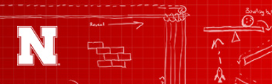

Statewide Partners:
Nebraska

Slide 7
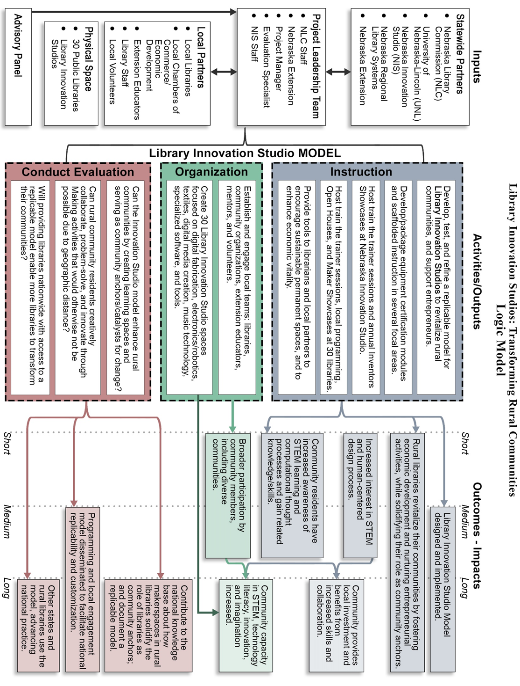
Birds-Eye View of Project

Slide 8
Local Partners
Add local Partners here (could cover who is on local action team, organizations contributing trainers, etc.):

Slide 9
How does the Projects Goals Overlap with our Community Goals?
…Empowered with the tools and guidance to explore, collaborate, create, learn, and invent;
  Entrepreneurship/Business Development
  Economic Development
  Lifelong Learning/Education
  STEAM – Science, Technology, Engineering, Art, Math
...Transform communities through participatory learning spaces…
  Sharing knowledge
  Learning from others
  Finding solutions together

Slide 10
What happens at the local level…
Local Community Action Team works together to:
Provide Trainers to train/certify those interested to operate the makerspace equipment,
Communicate with Statewide team on issues that may arise with equipment and Standard Operating Procedures,
Work on sustainability strategies for a permanent studio locally (the Library Innovation Studio will only be at the library through ____add date__________.
Provide local marketing & programming/focus areas
Host Open House & Local Maker Showcase Events

Slide 11
What happens at the local level…
Library Staff and Local Trainers:
Provide scheduled training on equipment
Provide some consumables on site at reasonable prices (see library staff for price list although not all items on the price list may be available, please inquire)
Provide access to equipment at no cost to user (unless consumables are used up such as filament for the 3D printer)
Time limits on machines may be applicable (check with staff)
You may be able to reserve time on pieces of equipment (check with library staff)

Slide 12

Let’s Take A Look at the Stations & Kits Included with the Library Innovation Studio currently at the Loup City Public Library…

Slide 13
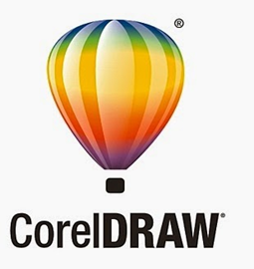
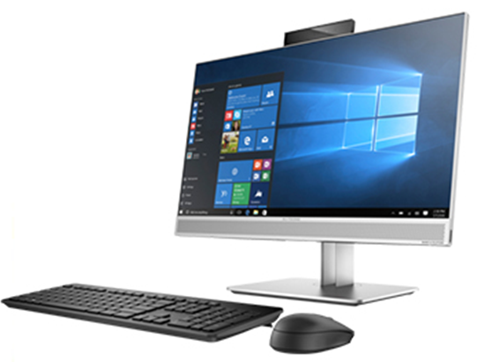
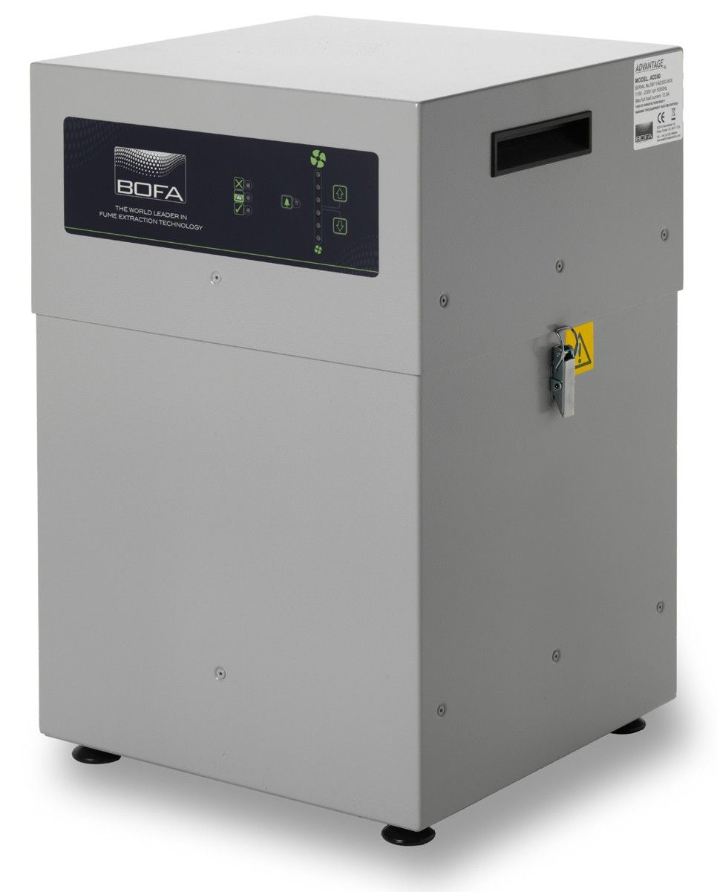
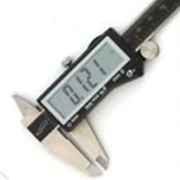
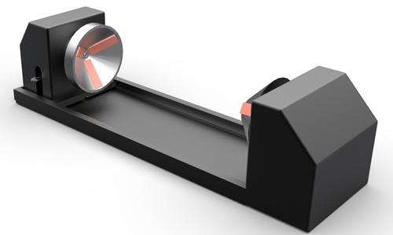
Laser Cutter Station
Universal Laser System VLS2.30 with 30W laser and Rotary Fixture
BOFA AD350 Laser Fume Extractor
HP EliteOne Desktop Computer with CorelDraw and One Touch Software
Caliper (measuring devise)
Consumables for sale: Birch Plywood, Cork coasters

Slide 14
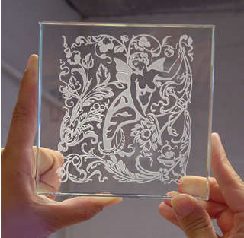
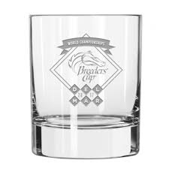
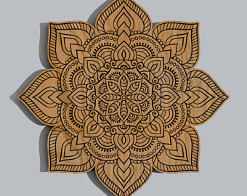
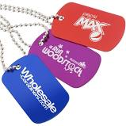
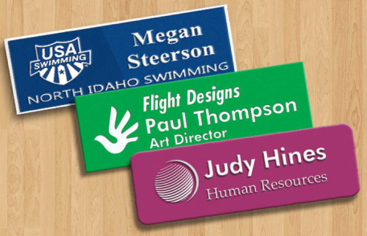
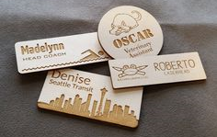
What Can you make with a Laser Cutter/Etcher?

Slide 15

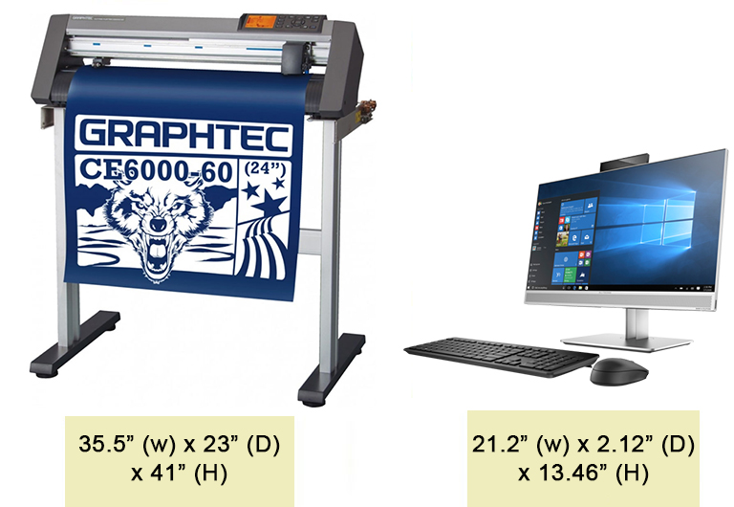
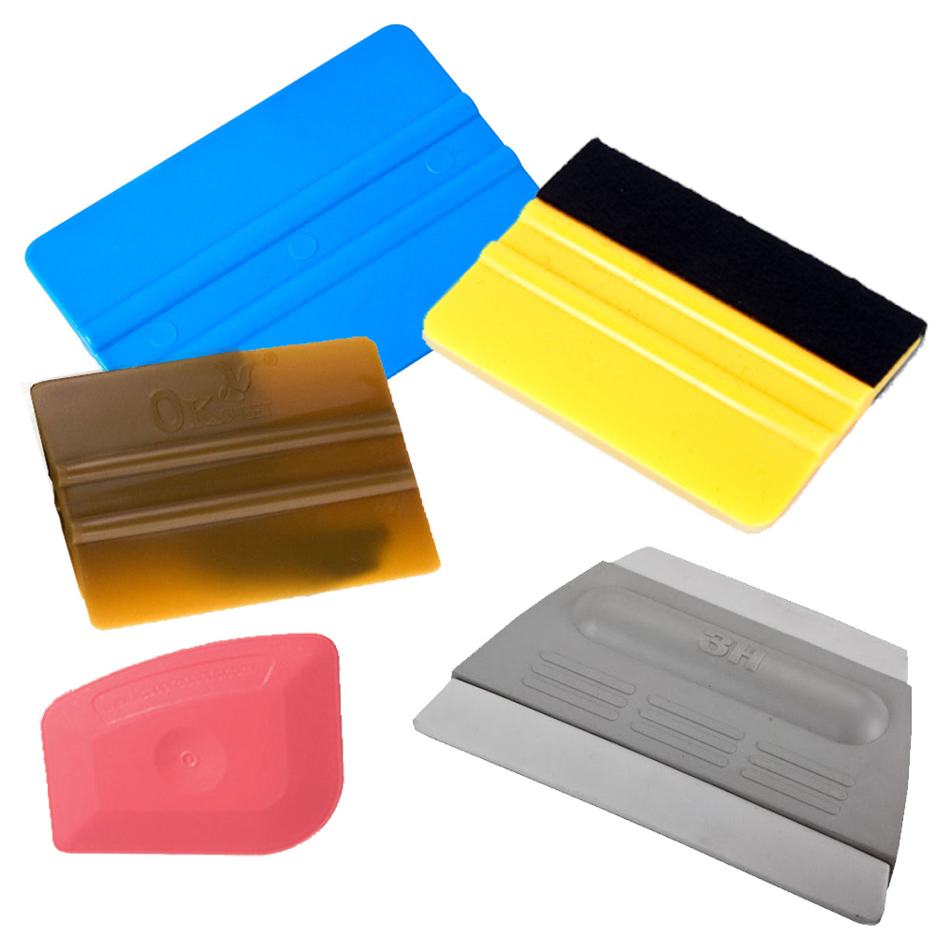
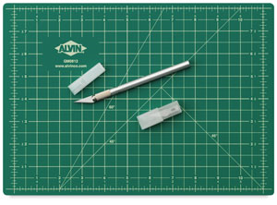
Vinyl Cutter Station
Graphtec CE6000-60 24” Wide E-Class Cutter & Stand
HP EliteOne Desktop Computer with CorelDraw
Alvin Pro Self Healing Cutting Mat
Exacto Knives, Squeegees/Burnishers
Consumables for sale: Removable Vinyl with Transfer Film

Slide 16
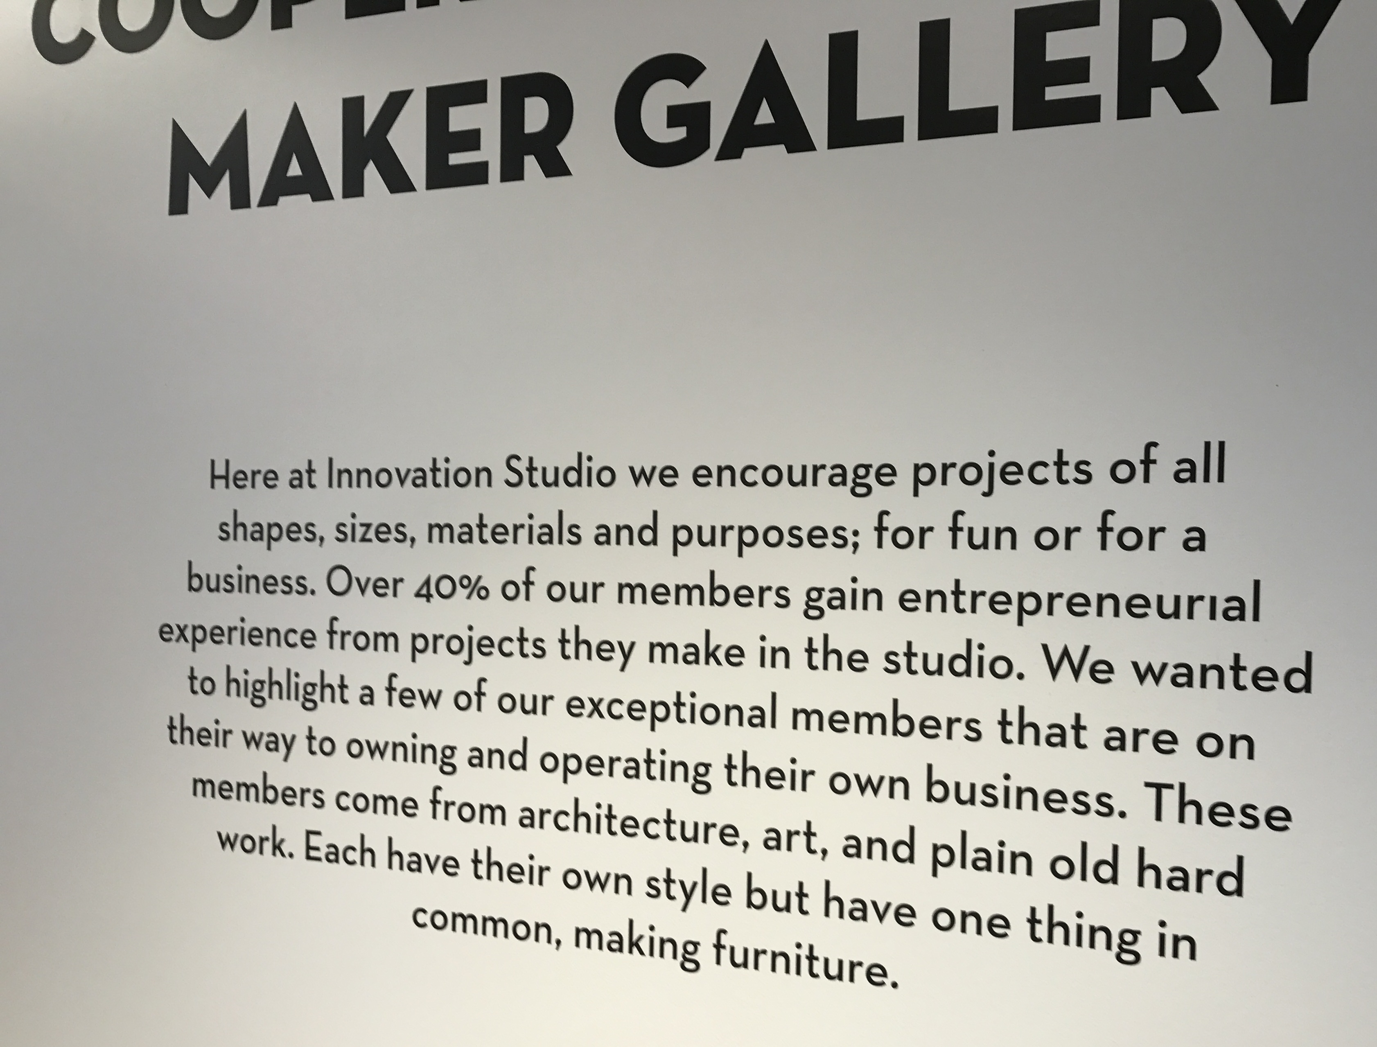
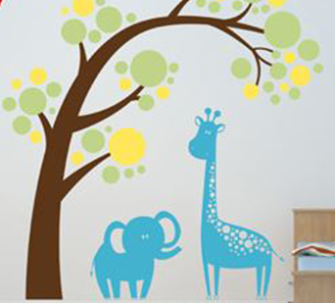

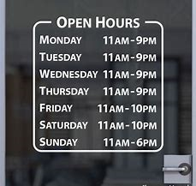

What Can you make with a Vinyl Cutter?

Slide 17
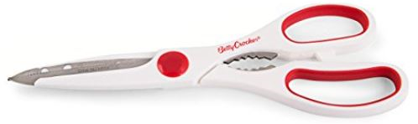
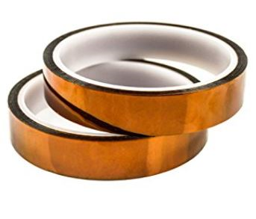
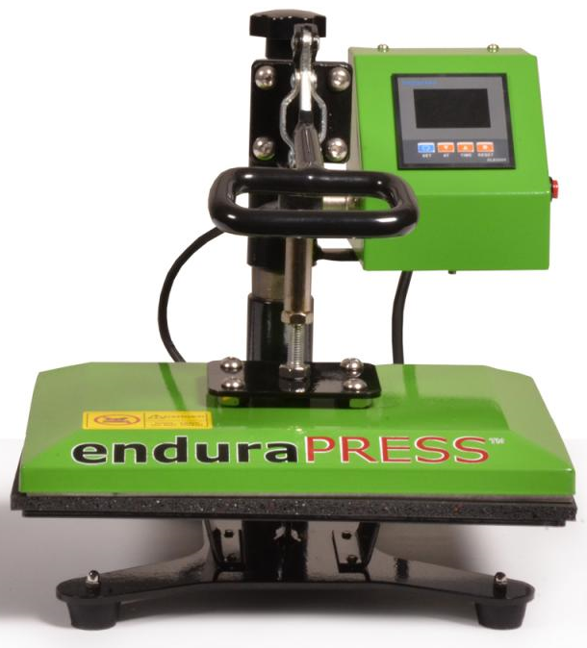
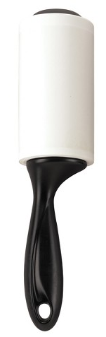
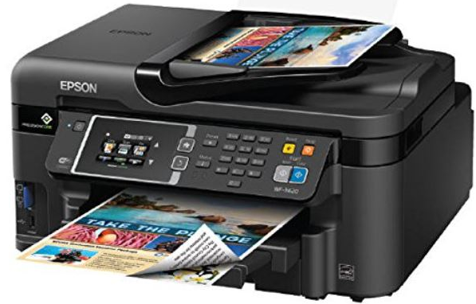
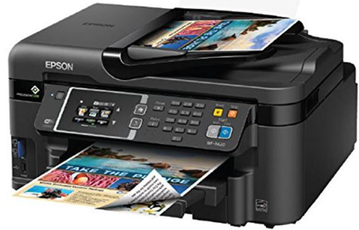
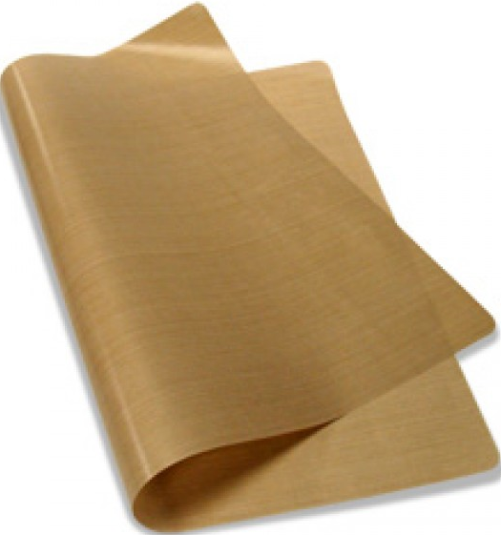
Heat Press + Sublimation & Pigment Printer Station
EnduraPress 9” x 12” Swing-Away Heat Press
HP EliteOne Desktop Computer with CorelDraw (same computer that runs Vinyl cutter)
Epson WF3620 Printer with Sublimation Ink
Epson WF3620 Printer with Pigment Ink
Supplies: Gloves, lint rollers, Teflon sheets, heat resistant tape, scissors
Consumables for sale: Heat transfer paper, T-Shirts

Slide 18
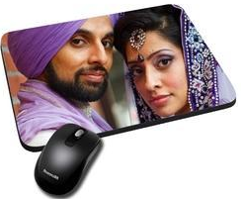
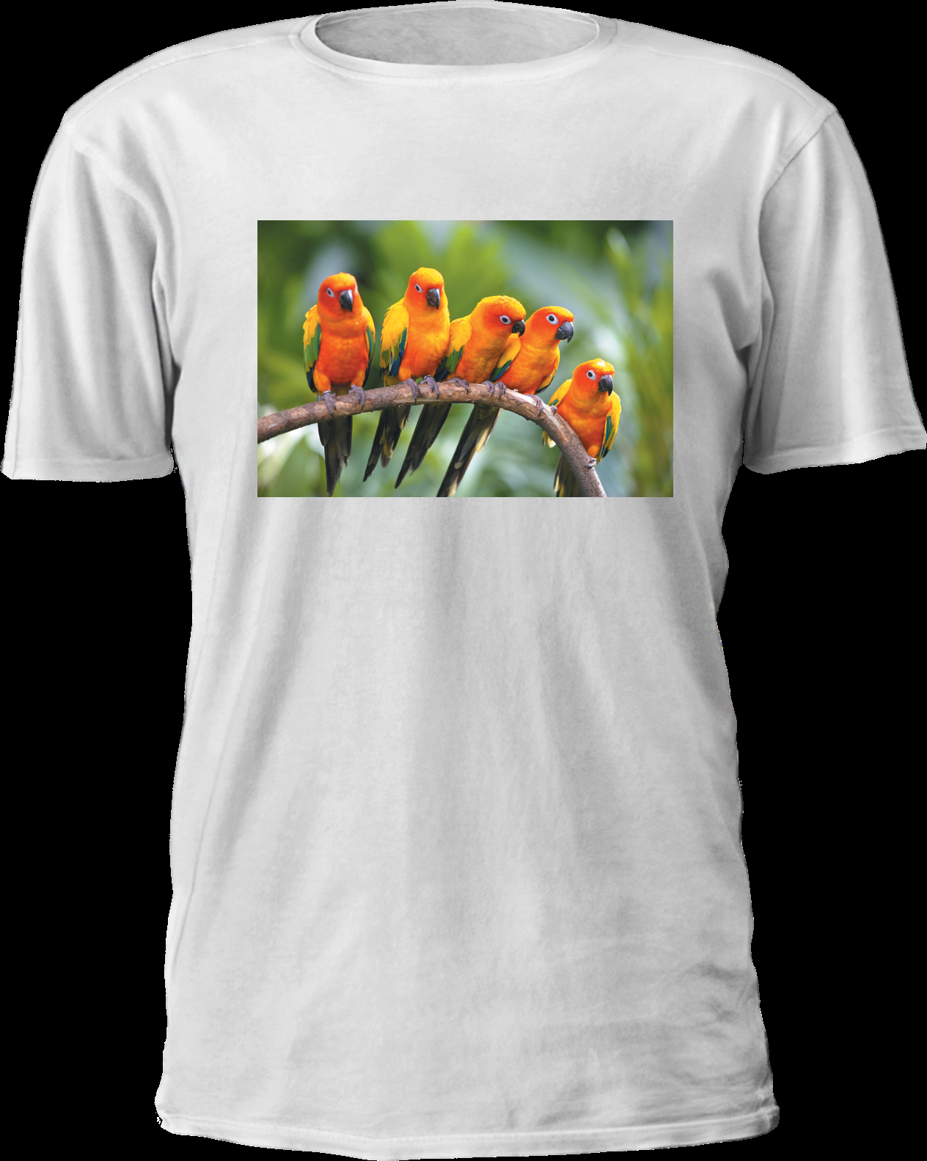

What Can you make with a Heat Press ?
You can use Sublimation or Pigment printed transfer paper with the heat press (available at your library). You can also heat press on ‘special’ vinyl (but not the vinyl that is available at the library. The vinyl available at the library is not “heat transfer” vinyl and cannot be used with the heat press.
The heat press will melt some types of fabrics and materials. Please read the SOP’s for more information.

Slide 19
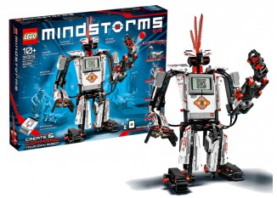
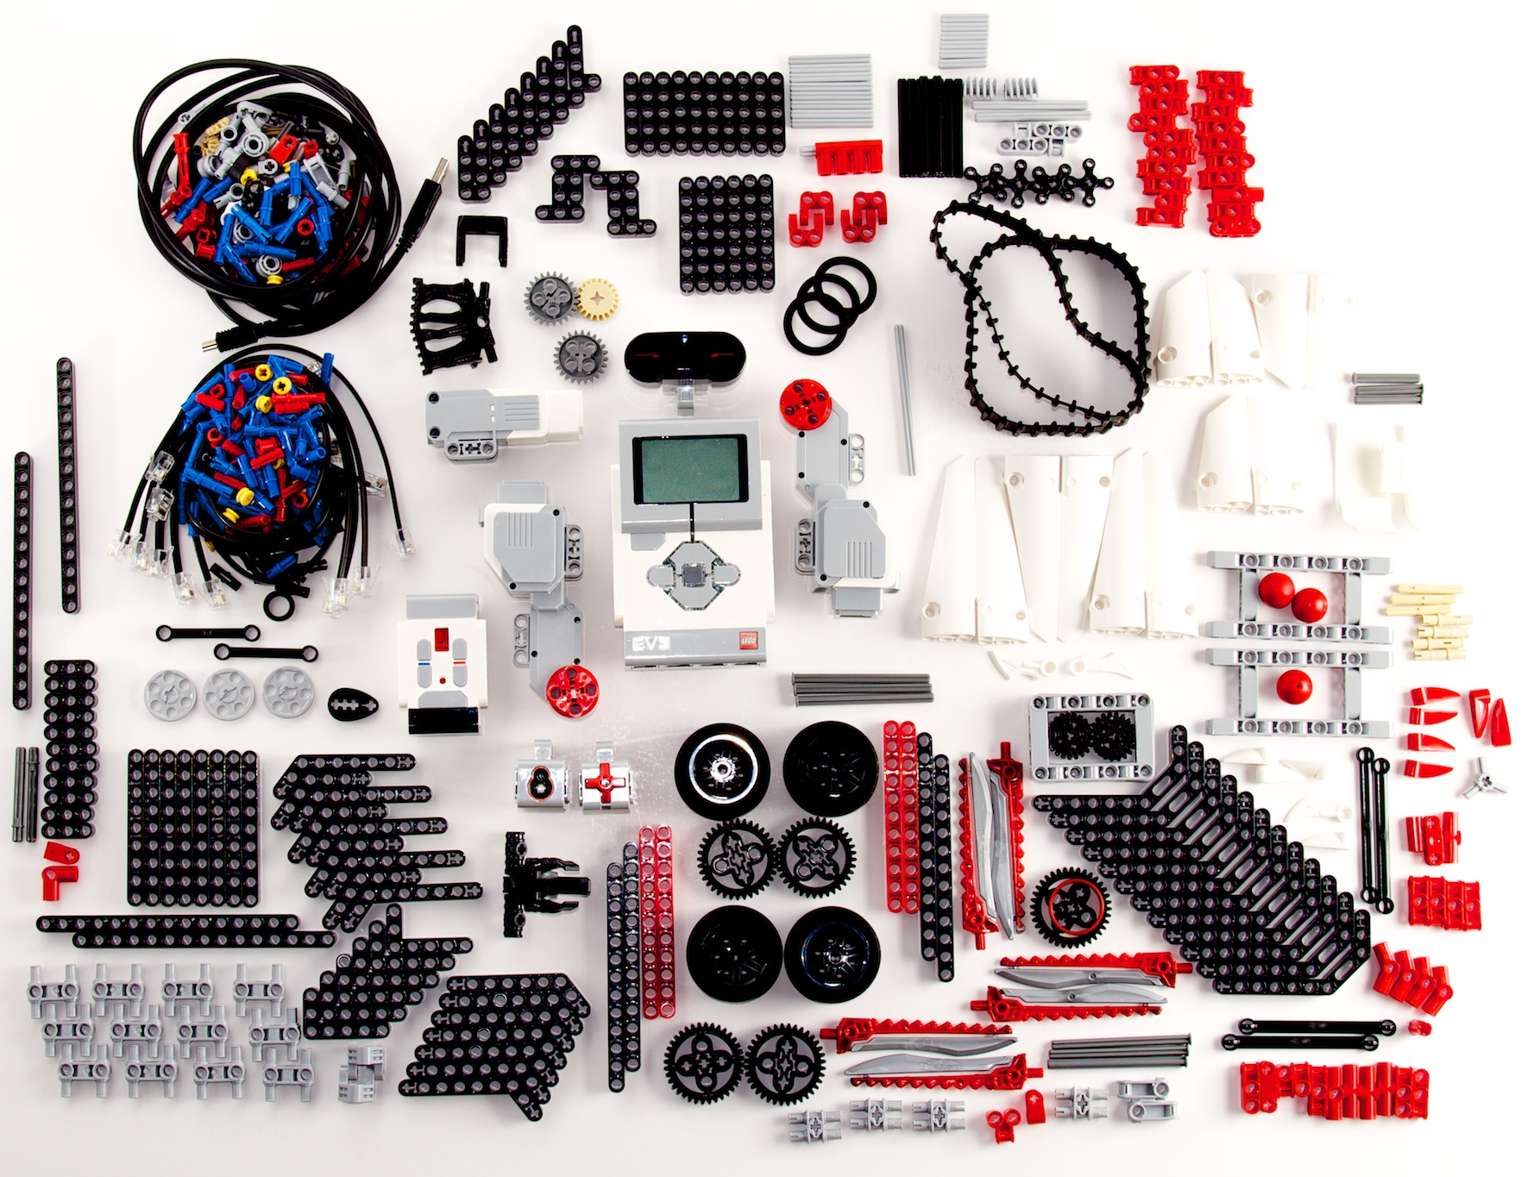
Lego Mindstorm EV3 Kit
https://www.lego.com/en-us/mindstorms/downloads/robot-commander-app
Build and program a personalized robot. Program your robot through an app (see web address above) on a mobile device or by using a personal or “Studio” laptop or others that may be available at the library.

Slide 20
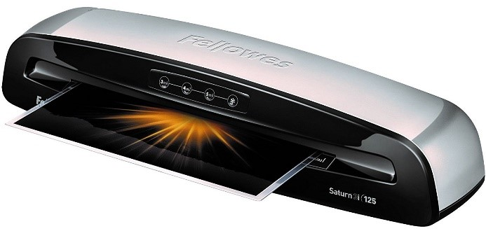
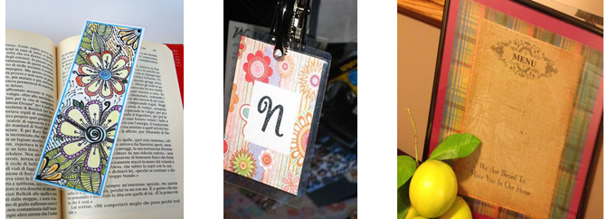
Laminator Kit & What you Can Make
Fellowes Laminator Saturen3i 125 HP EliteOne Desktop Computer with Consumables for sale: Laminator Sleeves in assorted sizes up to legal size to include luggage tag sleeves and loops

Slide 21
The current makerspace equipment (with the exception of Lego Mindstorm) leaves the Loup City Public Library February 20th. The equipment that will arrive in Loup City the week of February 20th includes…

Slide 22
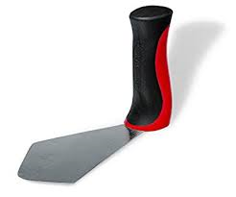
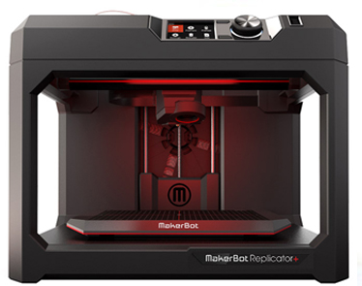
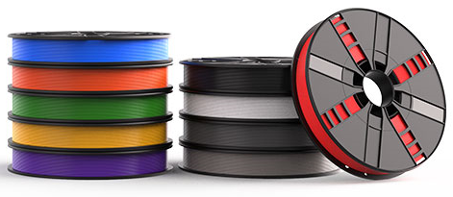
3D Printer Station
MakerBot Replicator+ 3D printer
HP EliteOne Desktop Computer
BuildTak Spatula
Consumables for sale: 10 colors of Filament (outside filament cannot be used)

Slide 23
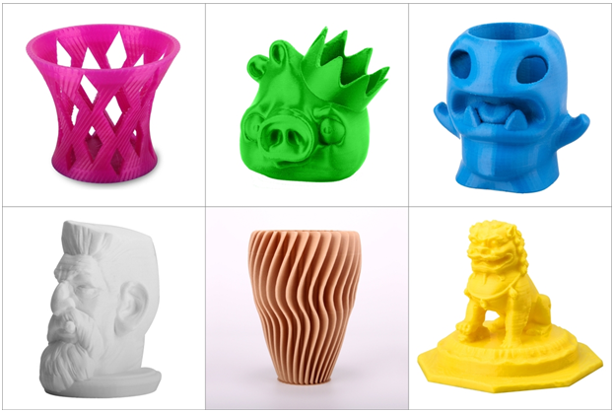
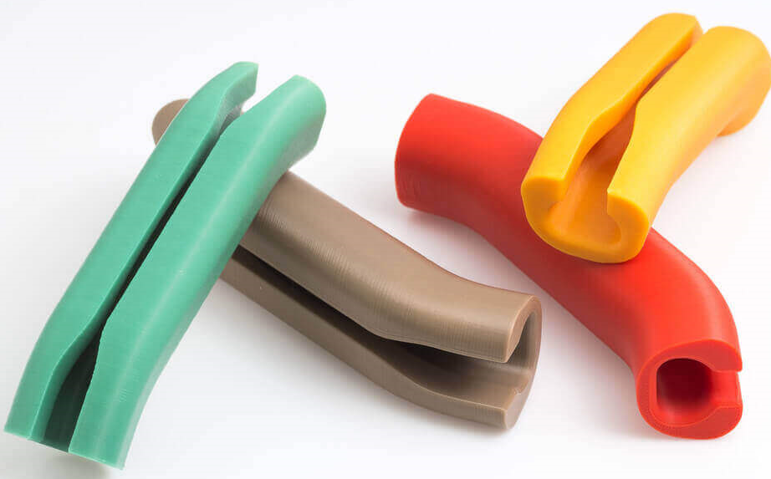
What Can you make with a 3D Printer?

Slide 24
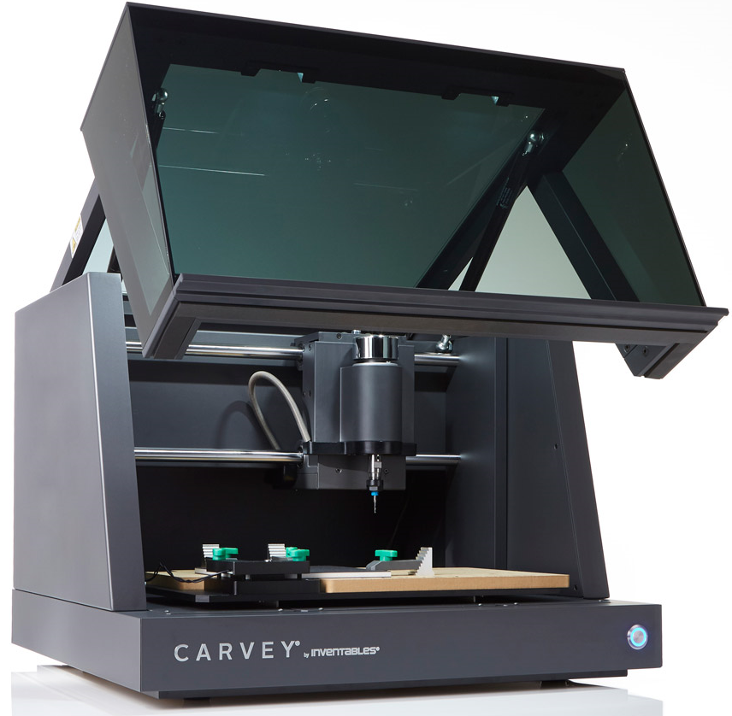
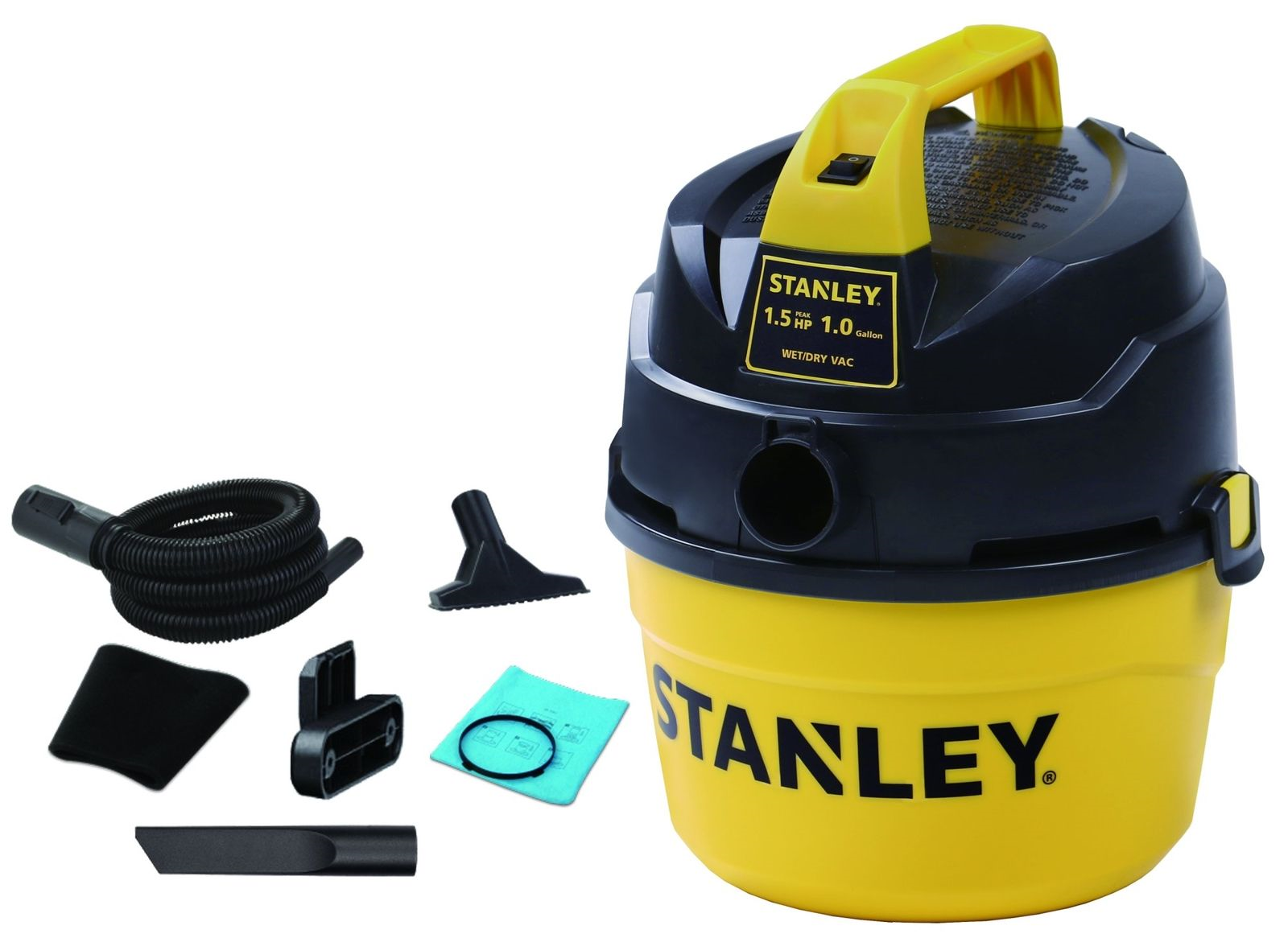
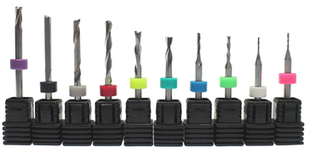
CNC Router/Inventables Carvey Plug & Play Station
Inventables Carvey Plug & Play CNC Router
Stanley 1-gallon shop vac
10 different carving and engraving bits
Consumables for sale: Birch plywood

Slide 25
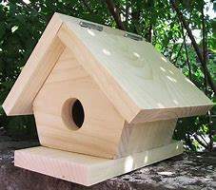
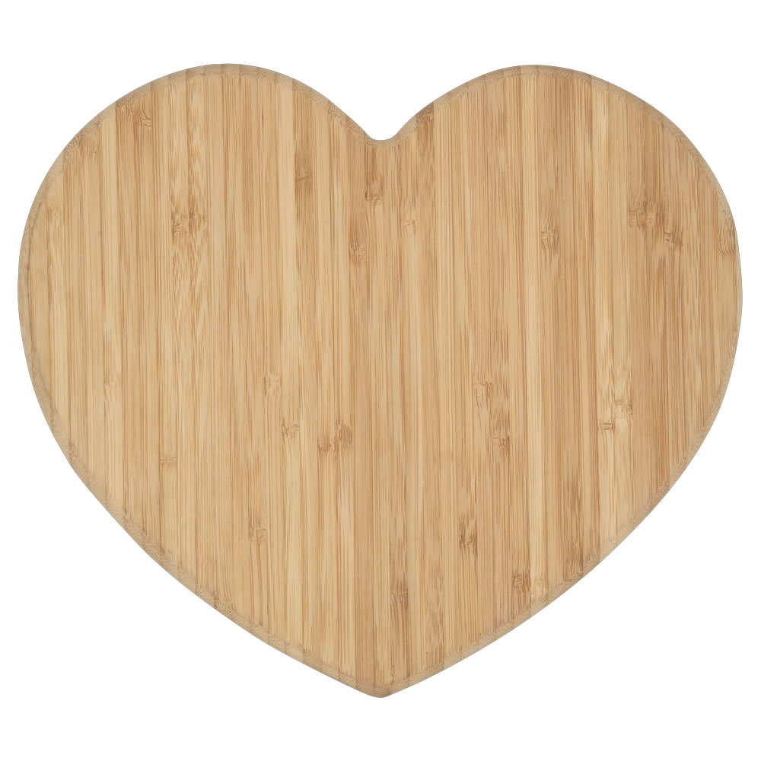

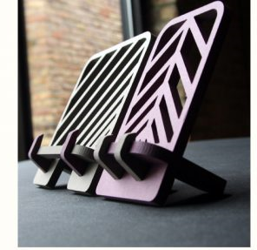
What Can you make with a CNC Router?

Slide 26

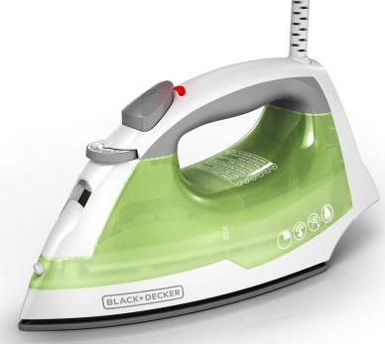
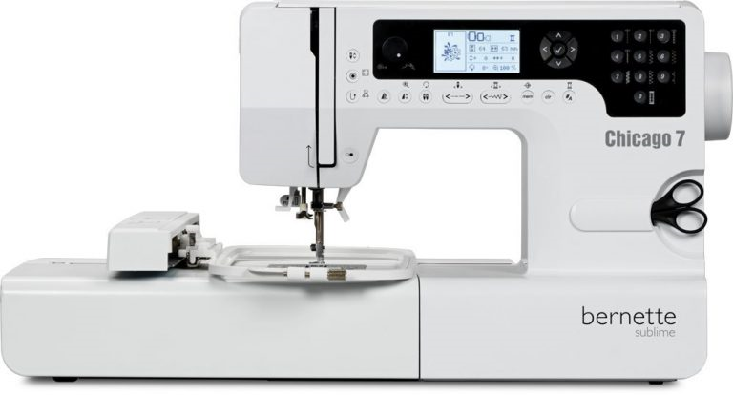
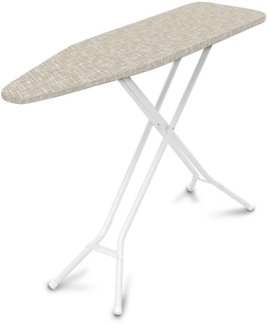
Bernette Chicago 7 Embroidery/Sewing Machine Station
Bernette Chicago 7 donated by Quality Sew & Vac, Grand Island, NE
Embroidery Patterns & Handy Roller Case
Black & Decker Steam Iron & Basic Ironing Board
Consumables for sale: Stabilizer (Thread provided at no cost; donations welcome)

Slide 27
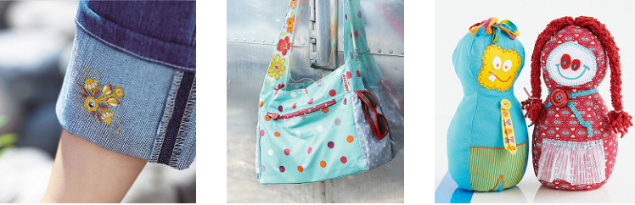
What Can you make with the bernette Chicago 7 Embroidery/Sewing Machine?

Slide 28
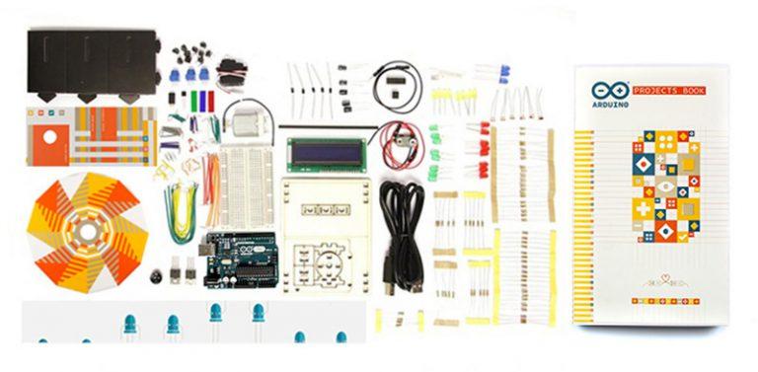
Arduino Starter Kit
The Arduino Starter Kit allows the user to become familiar with programming and includes 15 different projects. The kit may be powered through a connection with a laptop.

Slide 29
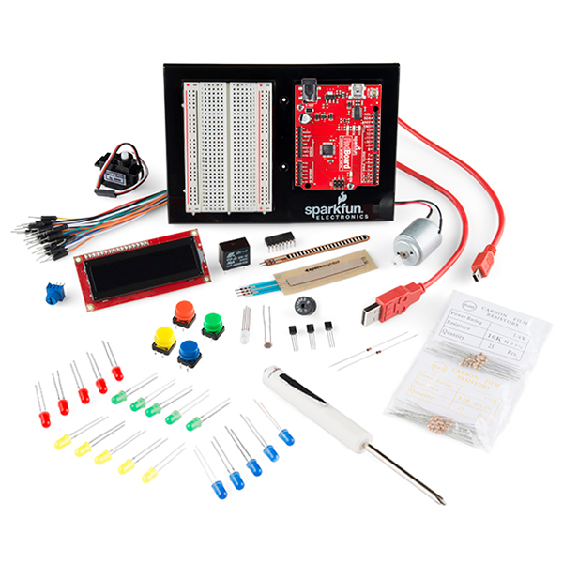
Sparkfun Inventor’s Kit
The SparkFun Inventor’s Kit allows users to construct a variety of circuits that use an Arduino Uno to read sensors, display information on an LCD, drive motors, and more. The kit will need to be connected to a laptop.
the SparkFun Inventor’s Kit. The kit allos users to construct a variety of circuits that use an Arduino Uno to read sensors, display information on an LCD, drive motors, and more. No previous programming or electronics experience is necessary. The kit will need to be connected to a laptop, which serves as both an interface and a power supply.

Slide 30
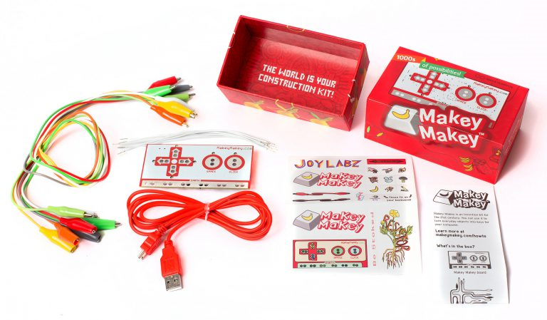
MakeyMakey Kit
The Makey Makey kit can turn everyday objects into touchpads and combine them with the internet. It’s a simple invention kit. Alligator clip two objects to the MakeyMakey board. Try turning banana’s into your keyboard!

Slide 31




Camera/Video Kit
Cannon EOS Rebel T6 Digital SLR Camera w/18-55mm Lens + bundle w/Bag
Green Screen Fabric w/clamps, Frame and Carry Bag
Steamer (to help you get the wrinkles out of the green screen)
SD/TF/CF/MS USB 3.0 Card Reader

Slide 32






Music & Recording Kit
M-Audio Keystation 49 II, 49-Key USB MIDI Keyboard Controller
Yamaha HPH-50B Compact Closed-Back Headphones, 7.5, Black
Focusrite Scarlett Solo (2nd Gen) USB Audio Interface with Pro Tools
Shure SM58-LC Cardioid Dynamic Vocal Microphone & Sampson Boom Stand
Reaper Software on HP Probook Laptop
Assorted Speakers, Cables, Hubs, and Connectors.

Slide 33


2.25” Button Maker Kit
2.25” Button Maker
Graphic Punch for 2.25” Button Maker
Toolbox Filled with Supplies for Easy Making
Consumables for sale: Pin-Back, Mirror-Back, and Magnet-Back Buttons supplies

Slide 34






Other Supplies that come with your Library Innovation Studio
Two HP Probook Laptops along with the Four HP EliteOne Desktops to run all the devices (3 with CorelDraw)
Weller WLC100 40-Watt Soldering Station
5 lb Halotron Fire Extinquisher
Medique First Aid Kit
Glue Gun with Glue sticks

Slide 35
Training & Certification
Visit the Loup City Public Library to find out how you can signup for upcoming training and become certified on the equipment that you would like to use.

Slide 36
Questions & Answers
The Library Innovation Studios: Transforming Rural Communities project is a partnership among the Nebraska Library Commission, University of Nebraska Lincoln (UNL), Nebraska Innovation Studio, Nebraska Extension, Regional Library Systems, and local public libraries—funded in part by the Institute of Museum and Library Services (Grant #LG-95-17-0046-17).

Slide 37
Statewide Contact Information
JoAnn McManus
Library Innovation Studios Project Manager
Nebraska Library Commission
402-471-4870
joann.mcmanus@nebraska.gov

